Slide 1

Staff Meeting
07.29.2024
Making a Positive Impact in the World

Slide 2

New Business Updates
RFP information is confidential and
should not be shared outside of IMI
Financial Planning Association of the Triangle (FPA-T)
Start Date: August 1
International Society of Pharmaceutical Engineering
Carolina-South Atlantic Chapter (ISPE-CaSA)
Start Date: August 1
Society for the Study of Reproduction (SSR)
Proposal Due: August 8 Start Date: January 1
The Society for the Study of Reproduction (SSR) was founded in 1967 to promote the study of reproduction by fostering interdisciplinary communication among scientists, holding conferences, and publishing meritorious studies, and contributing to the development and mentoring of young scientists.
Today we are a global association of more than 1200 active members, including scientists, veterinarians, students, and physicians, representing over 50 countries. Some members are engaged in basic or applied research, while others perform clinical practice. All are dedicated to advancing knowledge of reproductive processes in animals and in humans.

Slide 3

Staff & Client Updates
Meetings & Events Manager – full time position
Mary Kathryn “MK” Brewer
Start Date: August 19
Clients: ISPE-CaSA, NCASLA, & UFAA
Marketing & Communications – part-time position
Jennifer McNally
Start Date: August 1
Clients: CELA, ISPE-CaSA, PCICS, & PEDs
Membership Services Associate – part-time position
Still interviewing candidates

Slide 4
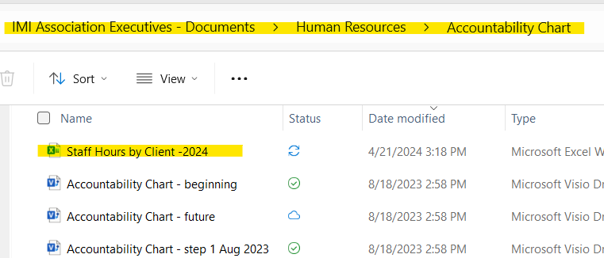

Slide 5

Importance of
Tracking Time
by Client

Slide 6
TIME TRACKING DATA FLOW
Client Contracts
Number of hours purchased by the client.
Staff Hours by Client.xls
Allocation of time for each employee for each client.
Time Tracker
Daily tracking of time spent on each client, broken down by job.
Account Executives and Managers
Updates Client Staff Time Usage report.
Board of Directors and IMI Leadership
Ensures hours are on track and makes necessary adjustments.
H/R and Accounting Departments
Ensures all data is entered.
Pulls data from Time Tracker.
Reviews for accuracy at a high level.
Analyzes data.

Slide 7
Time Tracking Data Flow
Example: NPRRA

Slide 8
Advantages of Time Tracking
Ensures Accurate Billing and Reduces Scope Creep: Tracking time helps ensure we are paid for all work done and reduces scope creep. Reporting on our time lets our clients know where their money is going and how much work we have completed for them.
Reduces Time Wastage: By analyzing the data, we can identify tasks that take longer than necessary and decide how to optimize or eliminate them.
Balances Workloads: Monitoring hours helps us ensure team members aren’t overwhelmed with work and provides visibility into who may have extra time to assist other teams as needed.
Improves Future Project Estimations: The metrics available from consistent and accurate time tracking allow us to estimate hours better for new projects or new clients.
Promotes Efficient Time Management: Regular time tracking encourages us to use our time more efficiently and wisely. By being more aware of how we spend our work hours, we can prioritize tasks better and reduce time wasted on less critical activities.

Slide 9



Please download and install the Slido app on all computers you use
Join at slido.com
#1348827
ⓘ Start presenting to display the joining instructions on this slide.

Slide 10

Please download and install the Slido app on all computers you use
How often do you forget to enter your timesheets?
ⓘ Start presenting to display the poll results on this slide.

Slide 11

Please download and install the Slido app on all computers you use
What’s the biggest challenge you face with timesheets?
ⓘ Start presenting to display the poll results on this slide.

Slide 12

Kudos, FUSE Updates and Other
IMI Anniversaries
Sabrina Hunt: Saturday, August 3; 9 years!
Do we have anything else to celebrate this week?
Any updates from the FUSE Committee?
Does anyone have anything else to share before we move to the Getting to Know Our Colleagues portion of the meeting?

Slide 13

Getting to Know Our Colleagues
Tell us about yourself (where are you from, name, family, etc.).
Tell us which clients you support.
What skill sets, resources, and/or platforms do you use regularly in your job at IMI? Maybe you could share your expertise with others.
What skill sets do you have that you are not currently using in your daily work and could offer to others if they need them?
What resources, platforms, skills, etc. would you like to know more about?
There may be someone else on staff who can help you learn more.
Tell us something more about yourself, personally.
An interesting fact or experience, something we may not know about you.

