Slide 1

Volunteer Management System
Author: Deb Doepp
September 6, 2023

Slide 2
Program Goals:
Design a formal volunteer structure
Create clearly defined roles and expectations as volunteers work on completing strategic plan goals
Increase engagement with the association and show additional value with membership
Provide a volunteer pathway to promote leadership development
Promote the success of the organization through the work of volunteers
Notes:
I thought it was important to identify some goals for this project to roll out a volunteer program for PBSA.
Designing a formal structure will allow members to know exactly what the process is to volunteer with PBSA and this structure will provide a way to measure it’s success
Creating clearly defined roles and expectations will help to ensure teams are working on the goals set within the strategic plan year over year. It will be intentional.
Increasing member engagement will not only allow the organization to profit, but it will also show the value of having a membership.
I know it was discussed at the Strat Planning meeting in July that there is a need to have a pathway to promote leadership development – this program would allow that development to happen.
The work each volunteer brings to the organization will allow us to promote the organization even more.

Slide 3
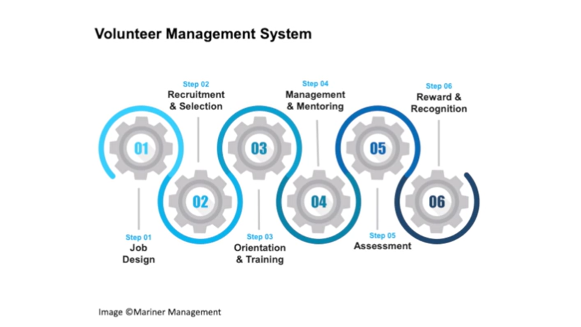
Volunteer Program Overview
Notes:
This graphic was taken from training that I completed through ASAE. It highlights the overall system that is often used to develop a successful volunteer program. It resembles common HR systems used in business today.

Slide 4
  Step 1 – Job Design
  Create template for all volunteer “job descriptions”
  Compile list of current volunteer opportunities in the association
  Develop a comprehensive Volunteer Handbook
Notes:
Let’s take a look at Step 1
1. Job Design. Each “job” – whether short or long term, should have a clear job description with one specific template for consistency.
The jobs can be identified by using the current Strategic Plan.
We will look at the bylaws to identify the makeup of each Committee and Council.
We will also consider the current trends in volunteering and create opportunities with this in mind (short-term assignments; micro volunteering options; along with long-term committee assignments)
2. Current Volunteer List
While there is a large Excel spreadsheet that is tracking the volunteers and Staff/Board Liaisons, this will need to be updated. The best option (to preserve the history of a member’s volunteering positions) is to put all of this information into the database (Impexium).
3. Volunteer Handbook
This handbook will be a centralized spot for the association’s policies, Code of Conduct, and COI/confidentiality agreements to mitigate risk.
The D&I team can be utilized in the development to ensure inclusivity.

Slide 5
  Step 2 – Recruitment & Selection
  Volunteer Application
    Sample HERE
  Volunteer Profile
  Volunteer Page on Website
    Sample HERE
Notes:
Step 2 – Recruitment & Selection
Volunteer Application
- In general, the application is an opportunity for the potential volunteer to tell their story and how they want to share their skills with the association.
- Only necessary information should be captured (current application doesn’t ask for enough information) to provide the association enough information to match interests and skills to current volunteer opportunities
- See sample
2. Volunteer Profile
- This can be created in the database (Impexium) so that we can track member engagement, skills, interests, and areas of expertise.
The data in the platform will allow staff to target specific skills and areas of interest and expertise to opportunities available in the association
3. Volunteer Page on Website
- Specific callout “Get Involved”
- This will highlight the current committees/councils/opportunities and link to the job description
- See sample

Slide 6
  Step 2 – Recruitment & Selection (cont’d).
  Recruitment Campaigns
  Adopt volunteerism as part of the association’s culture
  Formalize the selection process
Notes:
Step 2 (cont’d) Recruitment & Selection – some of this has been taken from the work LDC did on the Volunteer Pipeline project.
4. Recruitment Campaigns
This can be done annually or bi-annually to align with the AC and Board/leadership rolling off and completing their terms
We will need to use multiple methods of recruitment
Membership standalone emails
Targeted emails using member profiles
Social media campaigns
During the onboarding of new members
Word of mouth through current volunteers promoting the value of volunteering with the association
5. Adopt volunteerism as part of the association’s culture
Highlight volunteering as most important membership benefit with association – look at verbiage on any membership campaigns to make sure they include volunteering as a benefit.
Increase communication around the work of volunteers
Consistently affirming the work volunteers have done to the association’s membership
Noting that conference/webinar sessions that are brought to the event/membership by x number of your peers (volunteers)
Use personalized videos by volunteers to share their experience
Volunteer leaders share their experience at events (annual conferences)
6. Formalize the selection process
Applications to centralized staff member and sent to Staff Liaisons
Staff Liaisons can work with Incoming Chair to select new applicants
Some positions will be hand-selected
Utilize D&I and concepts throughout selection process to mitigate bias

Slide 7
  Step 3 – Orientation & Training
  Volunteer Portal
  Sample portal HERE
  Orientation
  Training
Notes:
Volunteer Portal
This central portal will create space for each team where they can access necessary documentation 24/7 in one central location
This will move us away from email and to each spot on the platform
This will also create more visibility to the work being done and reminders/deadlines can be built into each task
See Sample
Orientation
On-demand video in the LMS to provide information about
The association & history
Current strategic plan
Current leadership
Introduction to volunteer portal platform
Expectations of volunteers (volunteer handbook)
Training
We can look at the skills needed for each position and create specific training needed (when applicable)
Utilize the LMS to create various modules for leadership development

Slide 8
  Step 4 – Management & Mentoring
  Staff Liaisons
  Committee/Council Chairs
  Identify areas of concern
Notes:
Step 4: Management & Mentoring
Staff Liaisons
Provide support to all volunteers
Identify experienced volunteers to mentor the new volunteers
Have check-in points with each volunteer to see how things are going (3- and 6-month mark)
Provide opportunities for consistent feedback throughout their term
Review goals of the teams and monitor progress
Committee/Council Chairs
Provide support to new committee volunteers (check-in points)
Identify areas of support needed and communicate to Staff Liaison
Identify areas of concern
Staff Liaison to work with Committee/Council Chairs when challenges arise with a volunteer and address concern

Slide 9
  Step 5 - Assessment
  Create a loop of feedback
  Use data to adjust program
Notes:
Step 5 – Assessment
Create a loop of feedback
For staff: Provide feedback to volunteer on their contribution
For volunteer: Staff Liaison consistently available throughout the term & Develop a method of evaluation at end of the term to capture their experience and satisfaction
Use Data to Adjust Program
Volunteer descriptions
Platforms and how they’re working
Resources provided to volunteer
Timing of the work
Future leadership decisions
D&I considerations for future changes to the program

Slide 10
  Step 6 – Reward & Recognition
  Celebrate success
Notes:
Step 6 – Reward & Recognition
Celebrate success – we want to boost the volunteers and showcase the success of the organization because of the volunteers and their commitment
Personal thank you to each volunteer (email or phone call)
VOTM program
Public appreciation at events: ribbons for badges; volunteer reception; volunteer of the year award; thank you at Town Hall/Opening Ceremonies
Small, but impactful gift to show volunteer involvement is appreciated

Slide 11
Next Steps
Next Steps/Timeline
  Phase 1
    Program Outline
    Present to LDC Chairs
    Timeline w/ identified resources
    Budget Impact
    Notify all Staff Liaisons of the structure/expectations
    Compile list of all Volunteer Teams
    List all current volunteers across PBSA
    Update member profiles with current volunteer positions
    Identify and work with Impexium to create new fields for Member Profile*
Notes:
Phase 1: completion by end of December (estimated)

Slide 12
Next Steps
Next Steps/Timeline
  Phase 1
    Create a new volunteer application
    Create a new volunteer page on the website
    Review all Committee Descriptions to make sure they are in a template, are updated and approved by the Board
    Create an assessment for volunteers
  Phase 2
    Identify and build volunteer portal*
    Create a volunteer orientation video

Slide 13
Next Steps
Next Steps/Timeline
  Phase 2
    Work with D&I team to develop a volunteer manual
    Create a volunteer recruitment campaign
    Identify additional ways to promote the work of the volunteers
    Revisit the process and language used to onboard new members

Slide 14
Questions?

