Slide 1
TIME TRACKING DATA FLOW
Client Contracts
Number of hours purchased by the client.
Staff Hours by Client.xls
Allocation of time for each employee for each client.
Time Tracker
Daily tracking of time spent on each client, broken down by job.
Account Executives and Managers
Updates Client Staff Time Usage report.
Board of Directors and IMI Leadership
Ensures hours are on track and makes necessary adjustments.
H/R and Accounting Departments
Ensures all data is entered.
Pulls data from Time Tracker.
Reviews for accuracy at a high level.
Analyzes data.

Slide 2
Time Tracking Data Flow
Example: NPRRA

Slide 3
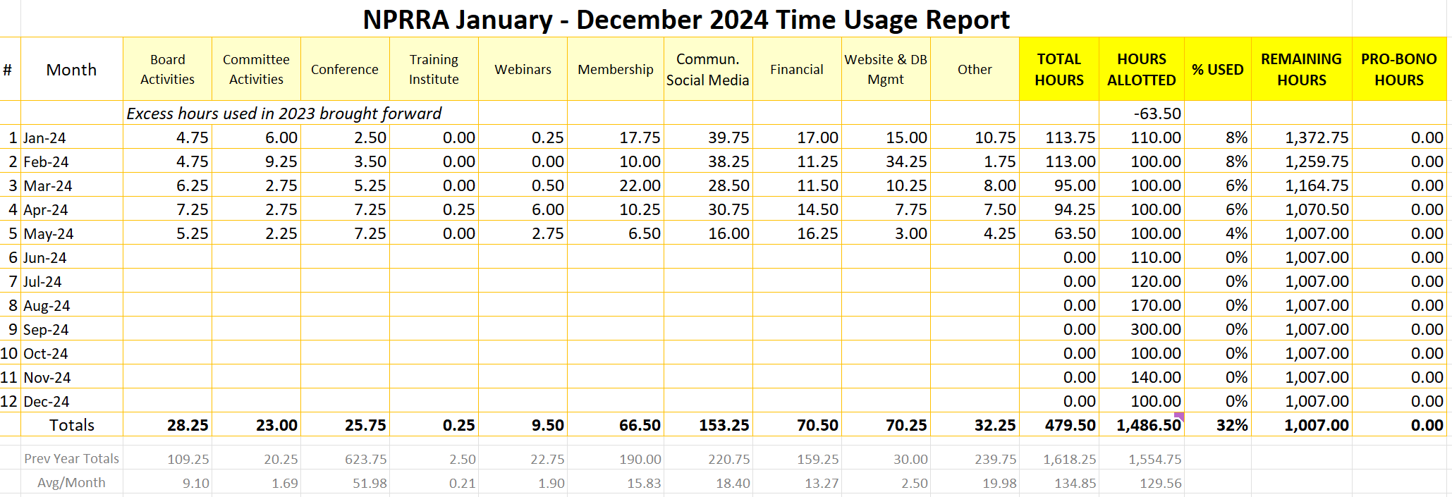

Slide 4
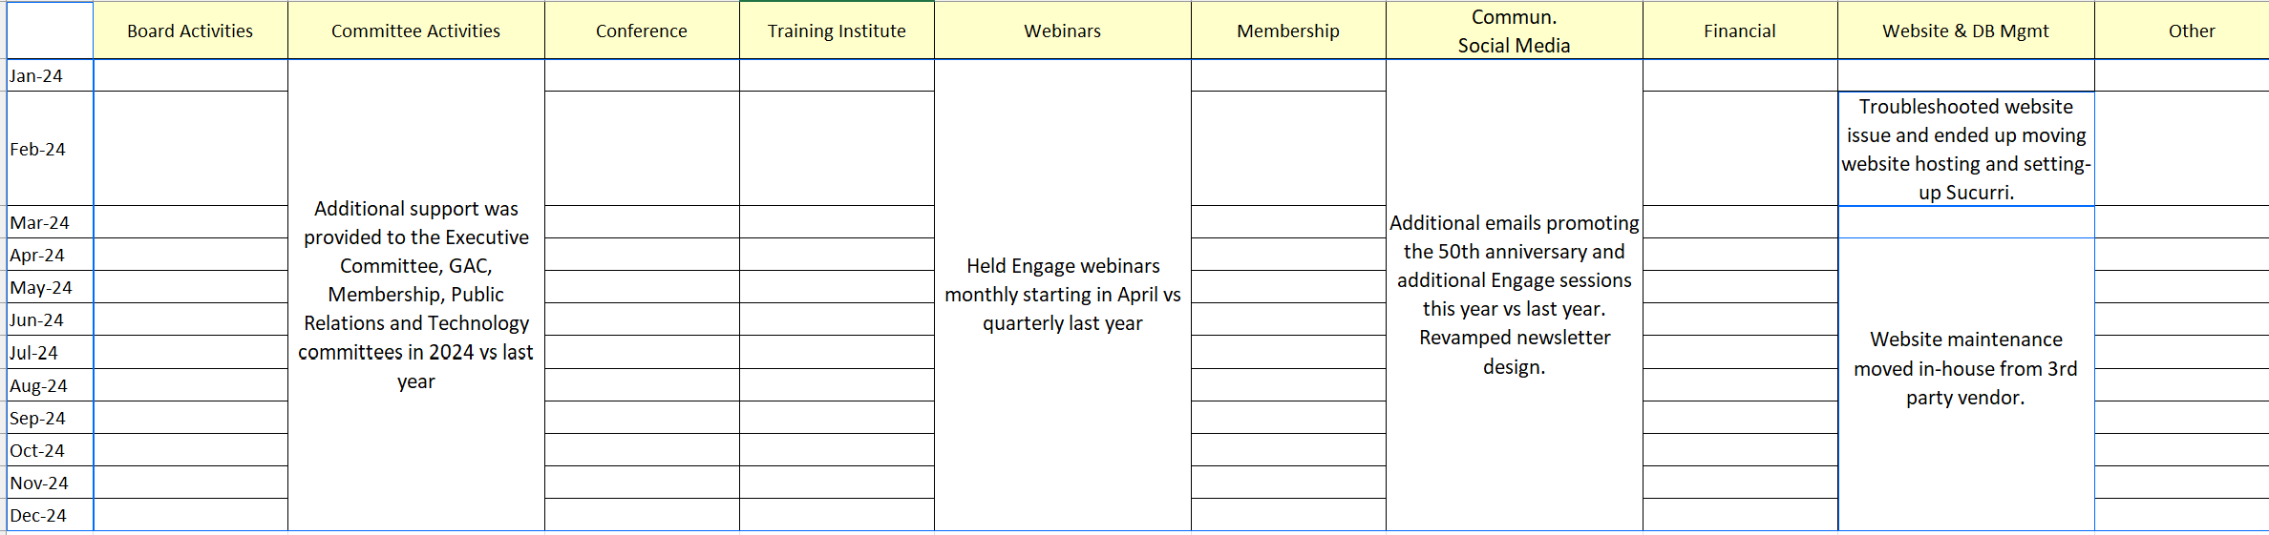

Slide 5
Advantages of Time Tracking
Ensures Accurate Billing and Reduces Scope Creep: Tracking time helps ensure we are paid for all work done and reduces scope creep. Reporting on our time lets our clients know where their money is going and how much work we have completed for them.
Reduces Time Wastage: By analyzing the data, we can identify tasks that take longer than necessary and decide how to optimize or eliminate them.
Balances Workloads: Monitoring hours helps us ensure team members aren’t overwhelmed with work and provides visibility into who may have extra time to assist other teams as needed.
Improves Future Project Estimations: The metrics available from consistent and accurate time tracking allow us to estimate hours better for new projects or new clients.
Promotes Efficient Time Management: Regular time tracking encourages us to use our time more efficiently and wisely. By being more aware of how we spend our work hours, we can prioritize tasks better and reduce time wasted on less critical activities.

Slide 6
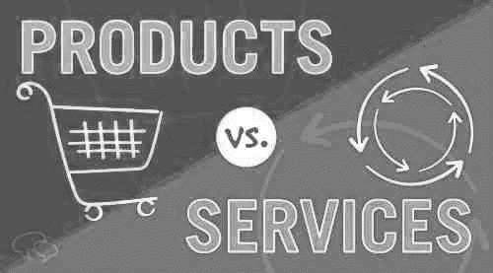
Those in the Conference Room: Examples of Product Companies
Those Attending Virtually: Examples of Service Companies

Slide 7

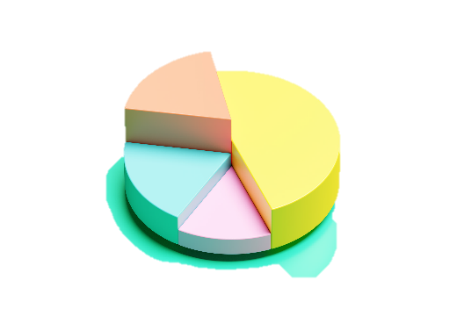
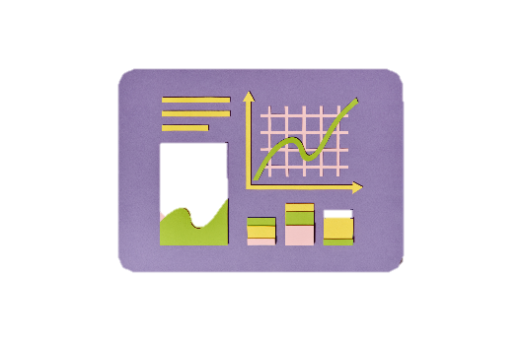

METRICS MEASURED BY COMPANIES
PRODUCT COMPANIES | SERVICE COMPANIES
PRODUCT COMPANIES
Sales Metrics units sold, revenue, sales growth Inventory Metrics inventory turnover, average number sold Production Metrics production volume, cycle time, etc. Financial Metrics gross margin, cost of goods sold, profit margin Quality Metrics defect rates, return rates, customer satisfaction
SERVICE COMPANIES
Time Tracking Metrics billable hours, non-billable hours Client Metrics acquisition cost, retention rate Project Metrics profitability Financial Metrics average revenue per client, profit margin Quality Metrics service quality, error rates, response time, customer satisfaction

Slide 8
TIME TRACKING DATA FLOW
Client Contracts
Number of hours purchased by the client.
Staff Hours by Client.xls
Allocation of time for each employee for each client.
Time Tracker
Daily tracking of time spent on each client, broken down by job.
Account Executives and Managers
Updates Client Staff Time Usage report.
Board of Directors and IMI Leadership
Ensures hours are on track and makes necessary adjustments.
H/R and Accounting Departments
Ensures all data is entered.
Pulls data from Time Tracker.
Reviews for accuracy at a high level.
Analyzes data.

Slide 9
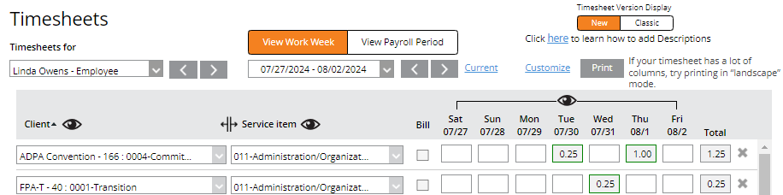

Enter time in real-time!
Recording time throughout the day as you switch tasks will ensure the most accurate records.

Slide 10
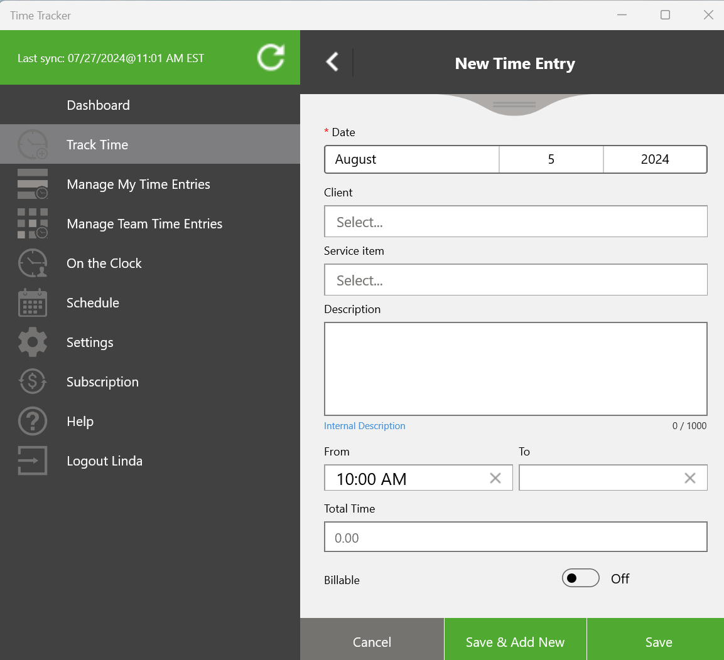
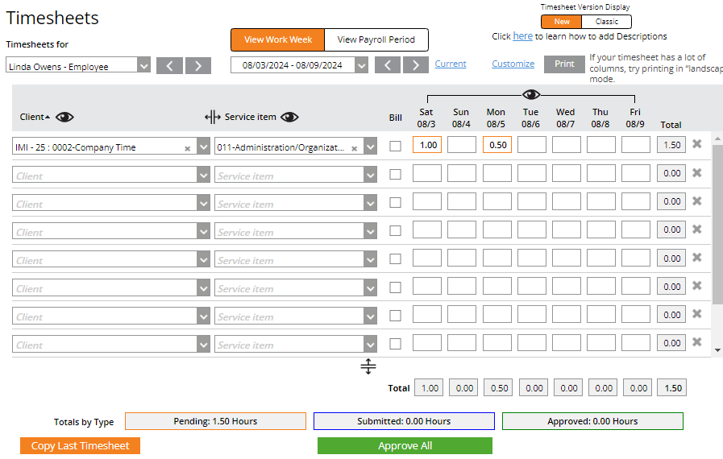
App vs Online Time Tracking

Slide 11
Enter time in real-time!
Recording time throughout the day as you switch tasks will ensure the most accurate records.

