Slide 1
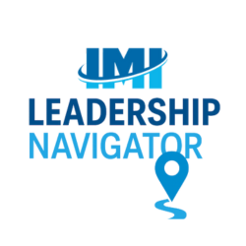

The Role of an
Executive Director
(Account Executive/Manager)
04.16.25 – 04.30.25
Notes:
Welcome! informal session - jump in at any time—questions, additional comments/insights. Want this to be collaborative/conversational, not just me talking the entire time.
1st ½ mtg: what it means to be an ED or Account Executive/Manager at IMI. Many of you are already well into your roles, but we want to make sure we have clarity around expectations and responsibilities.
2nd ½ mtg: high-level overview of Monday.com. Want this part of the mtg to also be interactive/
Don’t be shy—this is your space to ask questions, reflect on how you have done things up to this point, and how we can all grow together.
“None of us is as smart as all of us.” — Ken Blanchard
What is the biggest challenge you experience as an ED?

Slide 2
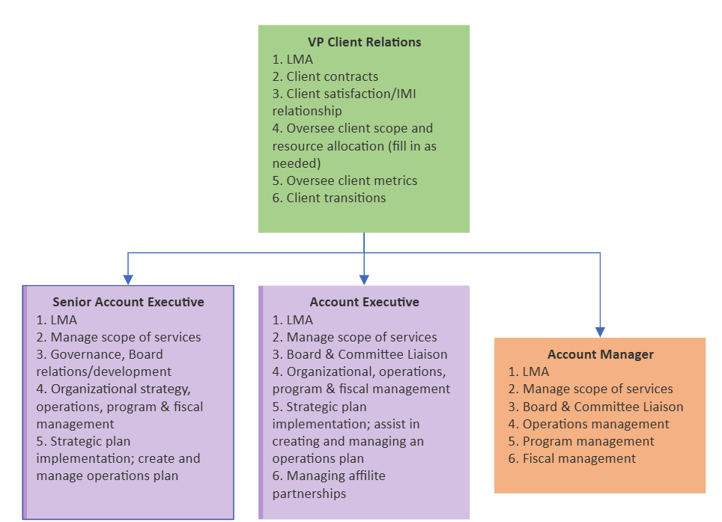
Levels of executive director responsibility at imi
Notes:
While all our ED (Account Exec/Mgr) roles are similar, the level of strategic responsibility varies from client to client.
The ED role is scalable—more complex governance and planning is required with the larger, more progressive clients.

Slide 3
Lma:
Lead, manage, and hold accountable
What It Means
Lead: Set the vision and tone for your client and team. Guide direction, motivate, and model IMI’s values.
Manage: Translate strategic direction into executable plans. Monitor performance, organize workflows, and anticipate challenges.
Hold Accountable: Ensure follow-through, address performance gaps, and cultivate a culture where results matter.
Notes:
Organize workflows = who does what, in what order, using what tools, and by when
IMI Expectation:
You're responsible for making sure the work gets done right, on time, and in alignment with IMI and the client’s policies and procedures.

Slide 4
Managing scope of services
What It Means
Know what’s in the contract and what’s not.
Clarify deliverables, timelines, and priorities.
Help the client understand what falls outside of core services and offer solutions—whether by using available extra hours or proposing it as a special project.
Flag potential overages early to the board and also IMI leadership team.
Notes:
IMI Expectation:
You are the gatekeeper of what IMI is responsible for delivering. This includes helping clients prioritize within their hours and budget.
Red Flag Example:
Board wants a major initiative with no extra hours — how do you respond?

Slide 5
Board and committee liaison
What It Means
Bridge communication between staff and volunteer leaders to keep everyone aligned and informed.
Prepare and organize meetings (agenda packets and follow-up)
Facilitate clear decision-making (decision papers!).
Manage committee expectations and structure.
Notes:
Manage Committee Expectations: As the ED, you're responsible for ensuring committee members:
Understand their role — advisory vs. decision-making
Know what they’re expected to accomplish and how their work fits into the broader goals
Don’t go off-course or duplicate work being done elsewhere (e.g., by staff or other committees)
Don’t expect unlimited staff time or out of scope support unless previously approved
IMI Expectation:
You help board members feel confident and supported. You don’t just “take notes”—you help move decisions forward and follow through on execution.

Slide 6
Operations management
What It Means
Oversee systems that support daily operations — including tools like Monday.com, file organization in SharePoint, and communication templates.
Ensure alignment across calendars, workflows, and team responsibilities for a more organized and efficient operation.
Proactively identify and resolve breakdowns in operations, anticipating client needs and helping the team stay ahead of potential issues.
Notes:
IMI Expectation:
Operations should run smoothly even when you’re out. You build systems your team can rely on.

Slide 7
program management
What It Means
Oversee the planning and execution of programs (e.g., conferences, webinars, certification, awards, etc.), ensuring they align with client goals and are delivered professionally.
Monitor timelines, budgets, vendor contracts, and promotion of programs/services.
Evaluate success and recommend improvements.
Notes:
Success Looks Like:
Attendees are satisfied, the board feels proud, and IMI looks like a trusted partner!

Slide 8
fiscal management
What It Means
Draft and monitor the budget in partnership with the Treasurer or appropriate committee.
Provide clear, analyzed reports to the board.
Identify variances early and provide recommendations.
Notes:
IMI Expectation:
Yes, we have an accounting department, but you must still understand the financial story and explain it clearly to your board.

Slide 9
Strategic planning
What It Means
Assist or lead the development and implementation of strategic goals.
Create or manage an annual operations plan aligned with strategy.
Track progress and provide updates to the board.
Notes:
IMI Expectation:
You help turn big-picture ideas into achievable plans.

Slide 10
Governance and board development
What It Means
Advise on board structure, nominations, and onboarding.
Provide governance best practices and resources.
Help build a strong, effective board pipeline.
Notes:
IMI Expectation:
You are a trusted partner in helping the board become more strategic, sustainable, and engaged.

Slide 11
Managing affiliate partnerships
What It Means
Oversee chapter relationships or other affiliate groups.
Standardize processes where possible.
Support consistency in branding, programs, and communications.
Notes:
IMI Expectation:
You help extend the client’s reach while ensuring cohesion and quality.

Slide 12
questions
Notes:
The Job of the CEO (account executive/account manager) is a combination of 1) working in partnership with volunteer leaders, 2) being visionary, and 3) doing what needs to be done."
Beth Brooks, CAE, The New CEO's Guide - Advice for the First-Time, Aspiring, or Current Association Executive.
What of the different aspects of the position would you like to further discuss?
The next topic will be: Supporting client growth (membership, revenue, efficiency).
Please come to the next meeting with your own examples as well as questions.

Slide 13
Ways to Go Above & Beyond Without Going Over Hours
Anticipate needs – Flag upcoming deadlines or renewal dates before the client asks.
Draft things early – Prep a first draft or outline for a meeting or report to save the client time.
Pre-organize decisions – Present options or next steps in a decision paper format.
Share best practices – If one client solved a similar problem well, share that approach.
Recap meetings – Send brief, clear follow-ups with action items and who’s doing what.
Use tools – Set up templates, checklists, or dashboards they can benefit from long-term.
Personal touch –send a quick “thinking of you” message.
Tech help – share a quick tip (ex. Excel or Chatty ;)
Offer feedback – Give tactful input on to lead meetings.
Streamline processes – Suggest a faster way to do recurring tasks.
Be a sounding board – Offer to hop on a quick call if they need to talk through something.
Spot inconsistencies – Gently point out errors, or unclear info before their audience does.
Curate resources – Send an article, sample policy, or tool that aligns with their strategic goals.
Encourage engagement – If a committee or board is disengaged, suggest a new meeting format.
Support their mission – Let them know when something they did made a difference to you or others.
Connect dots internally – If another IMI team has a helpful resource or experience, offer to connect them.
Make it easier for them to say yes – When requesting decisions, include context and a recommended path.
Keep tone warm and helpful – Your tone matters as much as your tasks!

