Slide 1


Situational Leadership

Slide 2
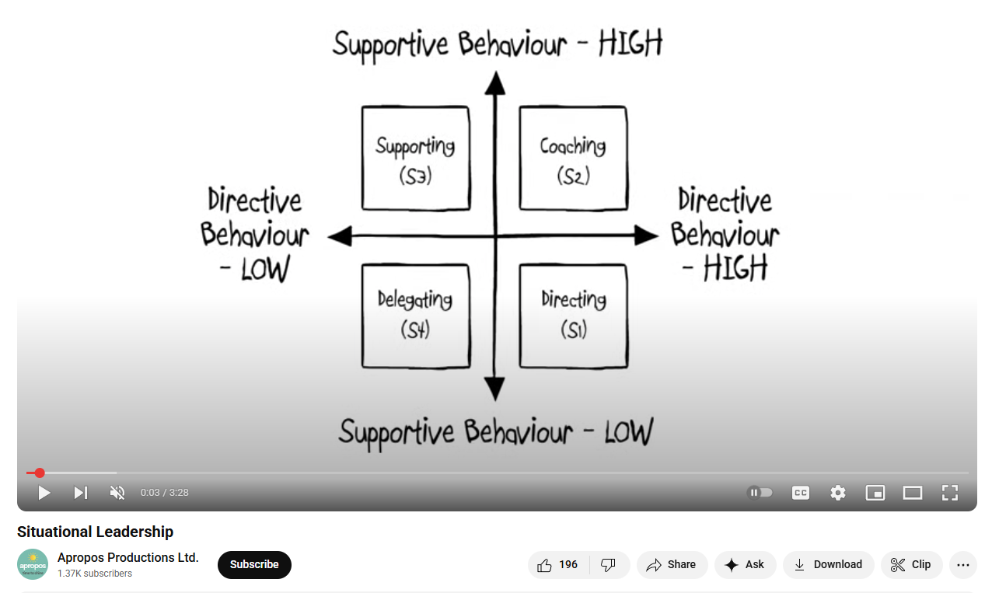
QUICK REFRESHER ON SITUATIONAL LEADERSHIP (3.5min video)
For full overview of Situational Leadership from 5.28.25 meeting, watch this video

Slide 3
questions

Slide 4
1:1 Meetings when you are delegating (d4)
Stay Conversations
Career Planning / Dream Projects
Opportunities to provide their input on client challenges
Flag potential client items that might impact them (even if it's not set in stone)
Ask, “What am I doing that’s driving you nuts?”
Ask where they’re blocked and need support/tools/resources
Ask, "What’s on your list that should live elsewhere?"
Get to know your direct reports – Icebreaker questions!
LMA – Leading, Managing, Accountability

Slide 5
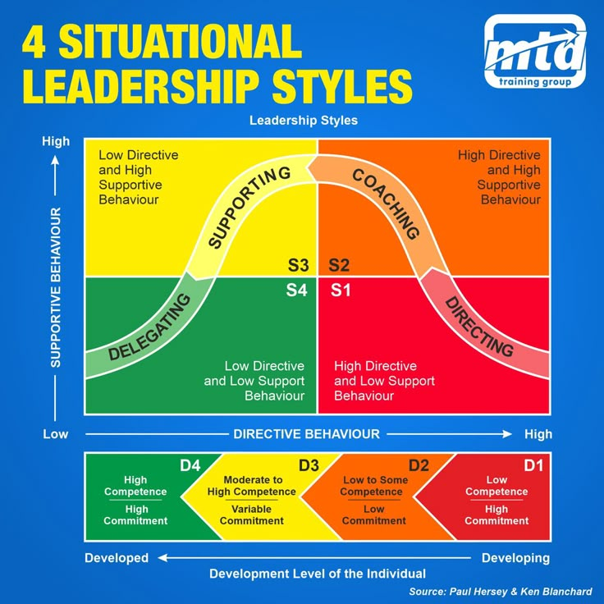

Slide 6
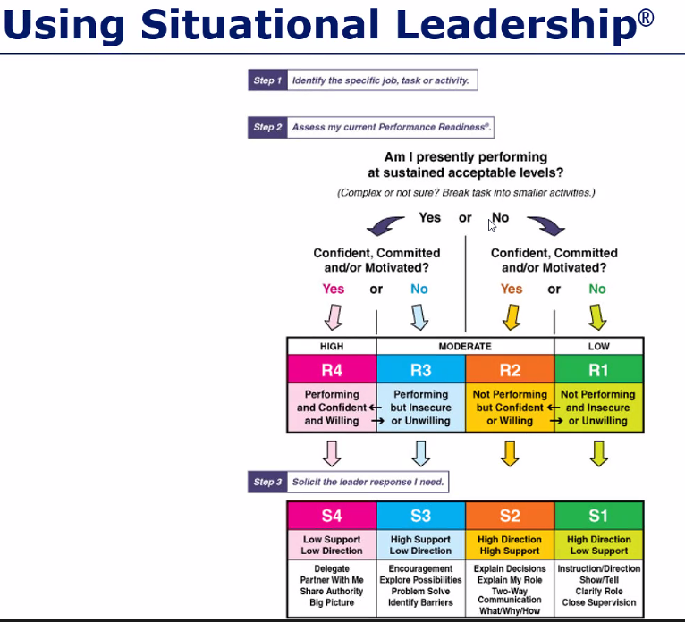
Note: This version uses "Readiness" Level instead of "Development" Level, but all concepts are the same.

Slide 7
Question to ponder:
How do you think performance is impacted when a person is experiencing a crisis? How would your leadership style be impacted if the person you're leading is experiencing a crisis?
(Relationship change, health problem for themselves or family, financial difficulty, stress from ANY source, etc.)

