Slide 1


Situational Leadership Part 2
06.11.25

Slide 2
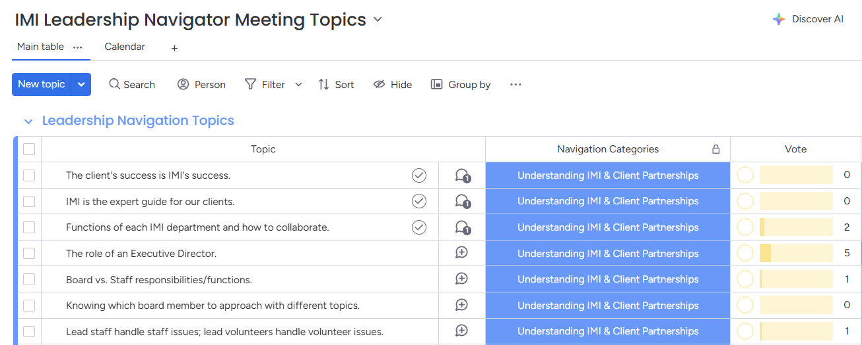
Leadership navigator meetings
What could we change about the Leadership Navigator Meetings to make them more meaningful and effective for you?
Link to Monday.com board with topics
POLL: Meeting Frequency

Slide 3
LEADERSHIP CHALLENGES - CRISIS
DISCUSS: How do you think performance is impacted when a person is experiencing a crisis?
(Major life change, relationship change, health problem for themselves or family, financial difficulty, stress from ANY source, etc.)

Slide 4
Practical tip
ASK your teams one of these questions:
What does it look like when you become stressed?
Using one word, how would people describe you when you’re stressed?
What do you want me to know about how you engage when you are stressed?

Slide 5
LEADERSHIP CHALLENGES
DISCUSS: How might your leadership style be impacted if the person you're leading is experiencing a crisis?
(Major life change, relationship change, health problem for themselves or family, financial difficulty, stress from ANY source, etc.)

Slide 6
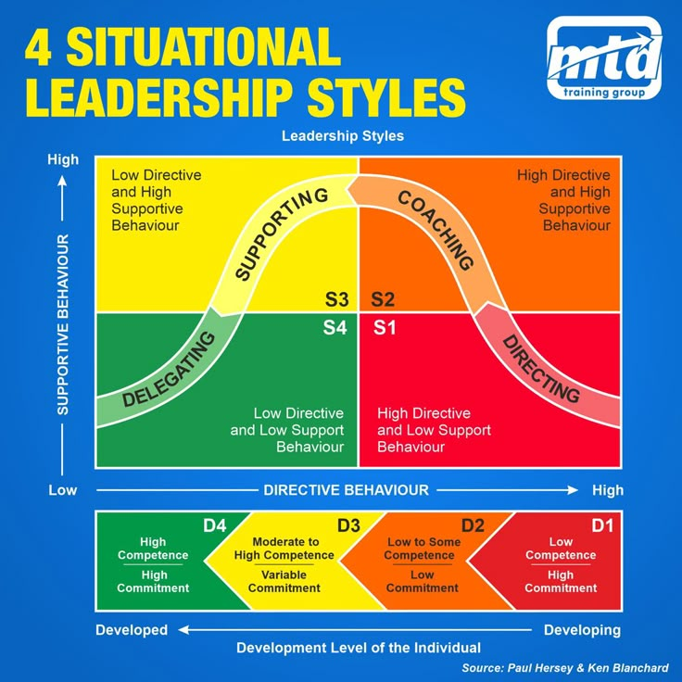
Regression

Slide 7
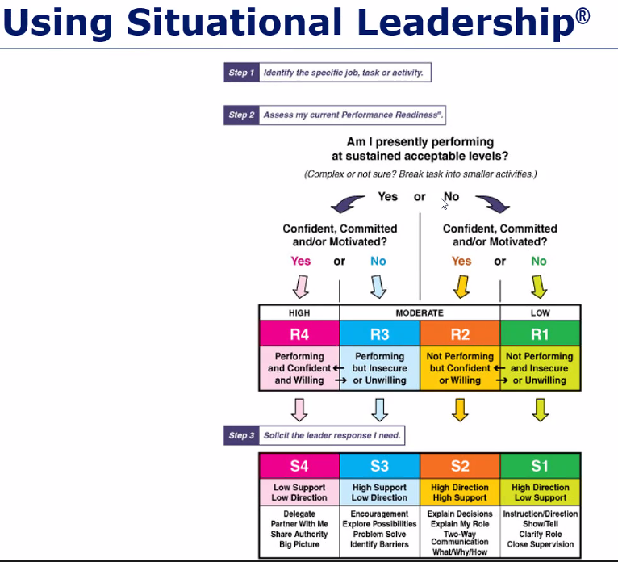
Note: This version uses "Readiness" Level instead of "Development" Level, but all concepts are the same.

Slide 8

LEADERSHIP CHALLENGES - TRAINING
You’re told to “dump the trash” – what questions do you have?

Slide 9
LEADERSHIP CHALLENGES - TRAINING
Put yourself in their shoes
Ask yourself what questions would you have if you were training to do this task on a new client?
Think about: what are the steps that if missed/completed incorrectly will bring you hate mail?
Monday.com and documentation
Context is king
Scenarios / practice / roleplay
💡

Slide 10
LEADERSHIP CHALLENGES - TRAINING
Scenario: Processing membership for a North Carolina Non-profit that only accepts members “from” North Carolina … what if?
Only live in NC half the year
Student in NC but ID & permanent address in GA
Employer in NC and they serve an NC audience, but they work remotely from TN

Slide 11
Note: This version uses "Readiness" Level instead of "Development" Level, but all concepts are the same.
During training, for most tasks your trainee may be at a R1 or R2 (D1 or D2).

Slide 12
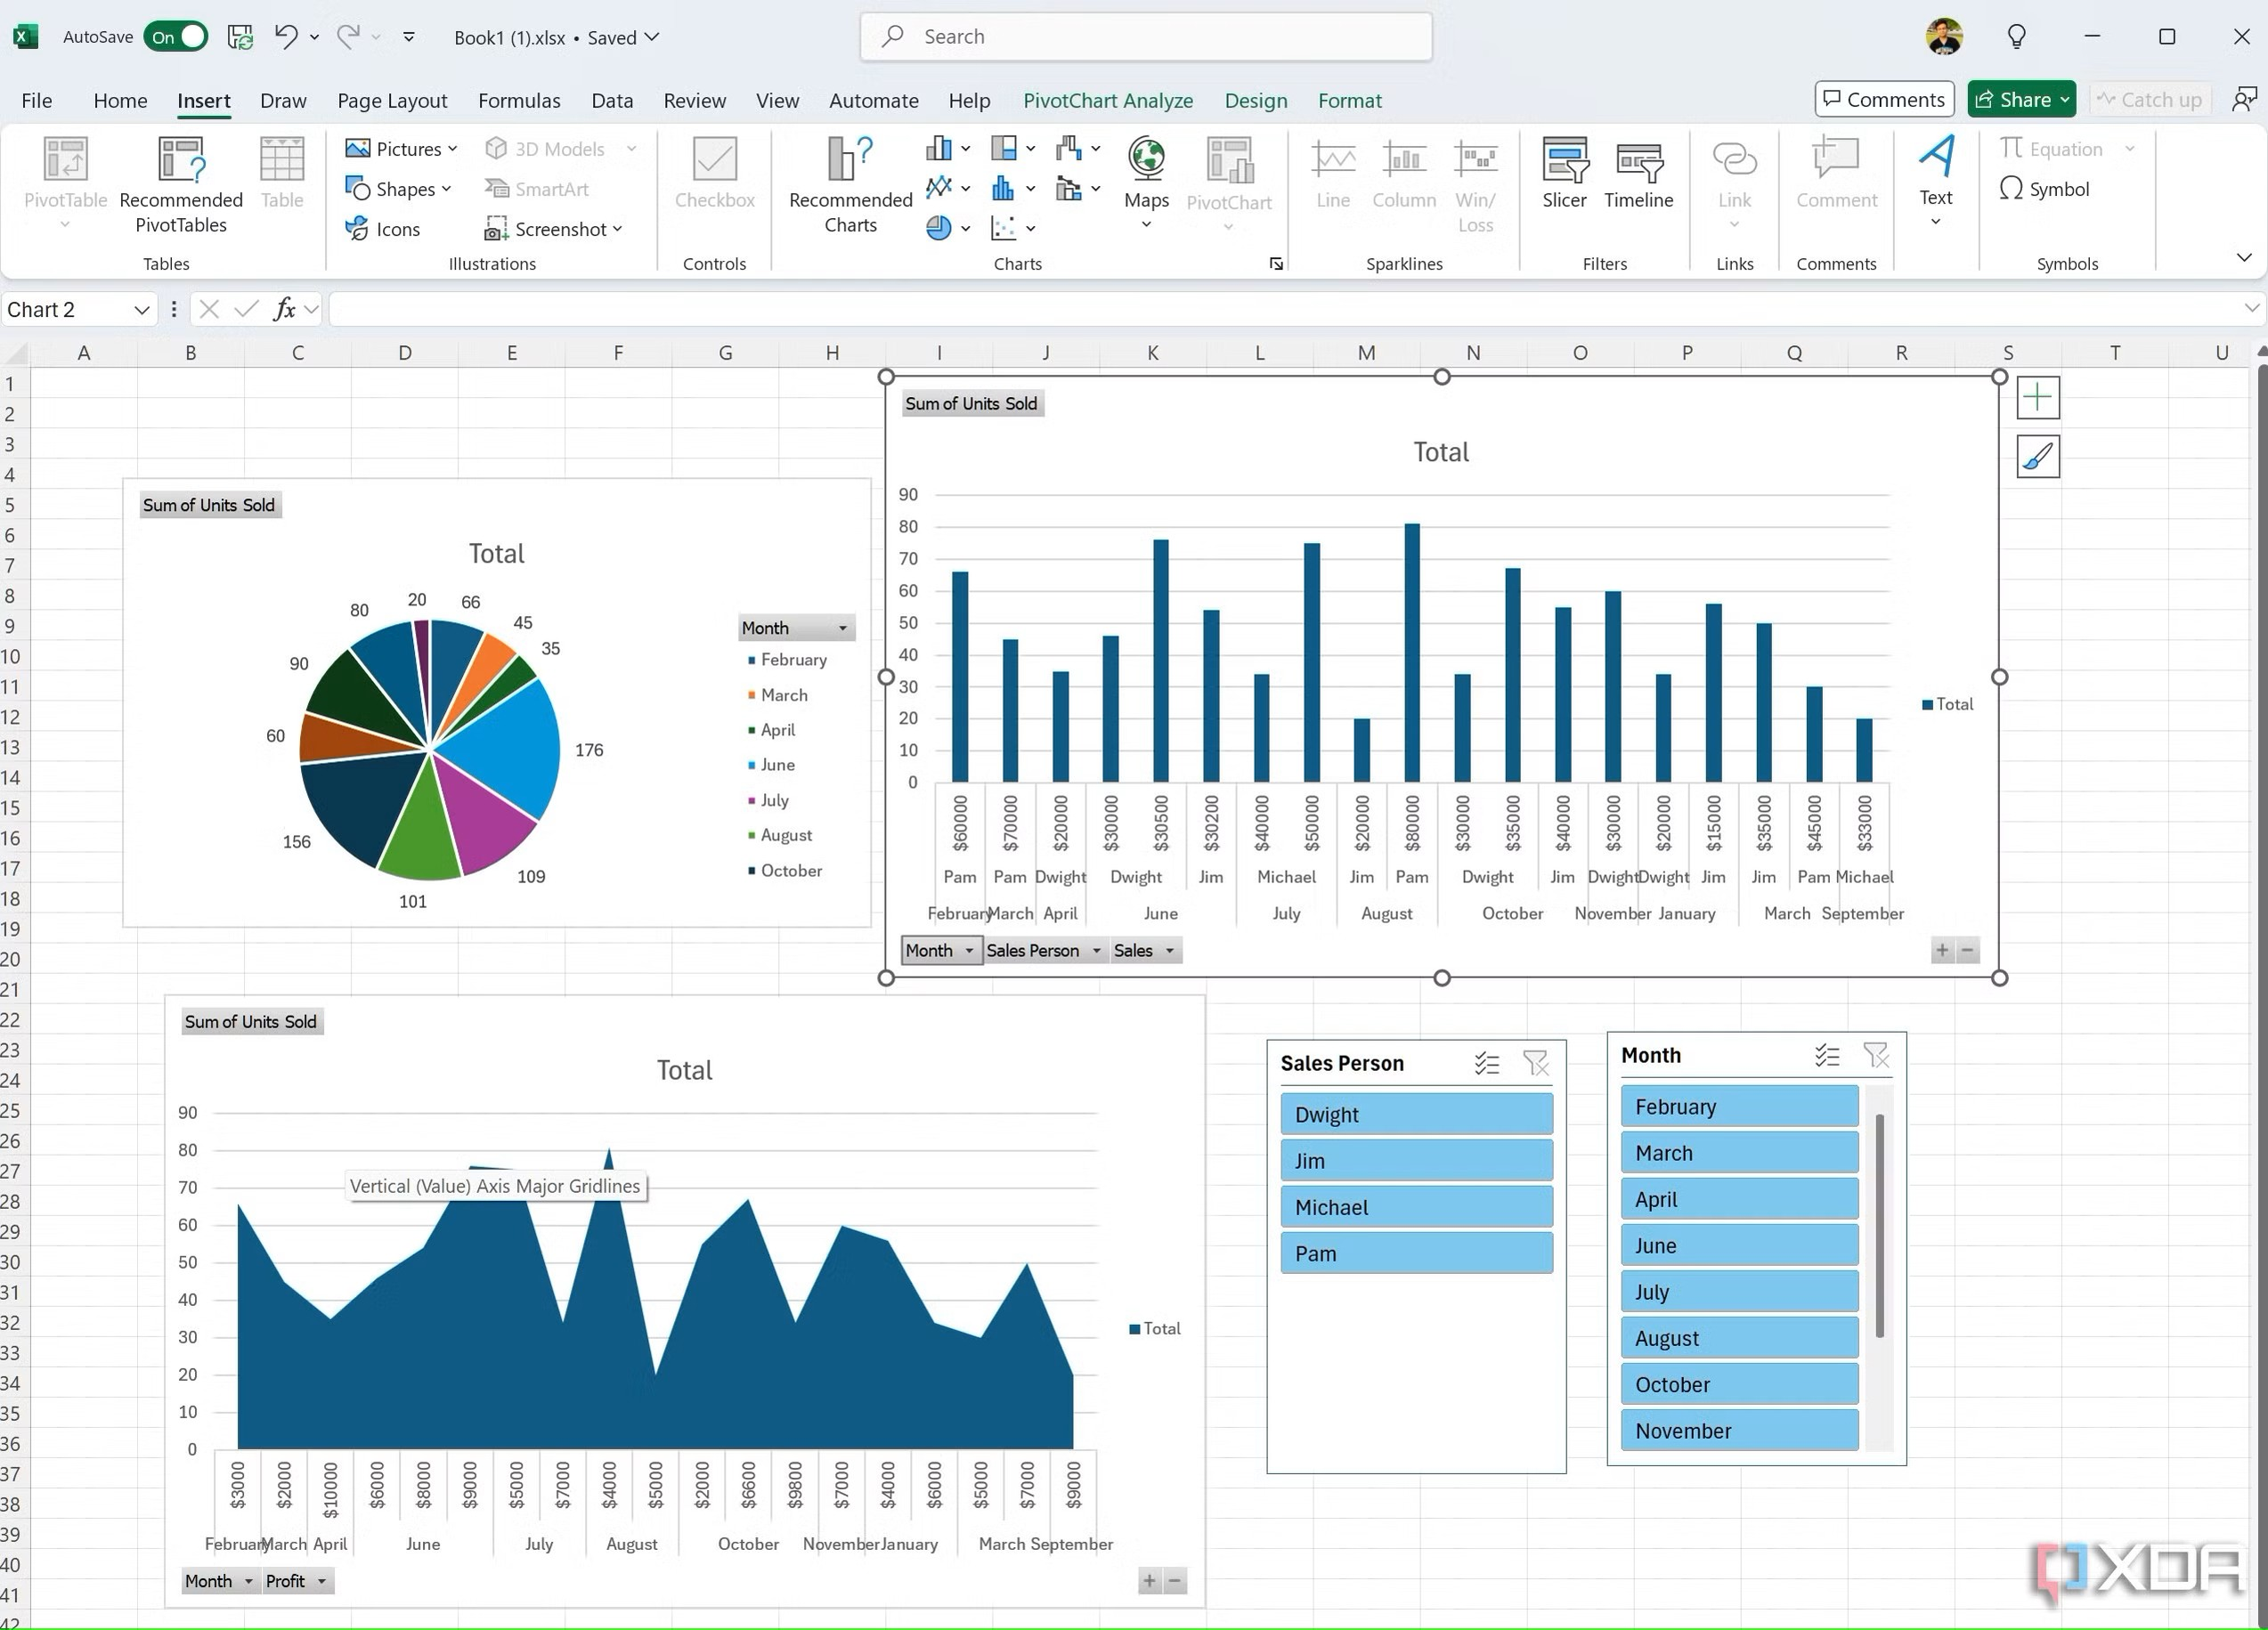
LEADERSHIP CHALLENGES - TRAINING
“The Dashboard of Destiny”
a true story

Slide 13
LEADERSHIP CHALLENGES – performance issues
Use the Situational Leadership model to evaluate where they are PER TASK.
Identify the specific areas where you are observing issues.

Slide 14
Use the Situational Leadership model to evaluate where they are PER TASK.
Think about their major areas of support and then break it down further.
Membership Example:
Processing memberships
Replying to emails
Running reports
Processing checks
Note: This version uses "Readiness" Level instead of "Development" Level, but all concepts are the same.

Slide 15
LEADERSHIP CHALLENGES – performance issues
DISCUSS: What are potential root causes of perceived performance issues?

Slide 16
LEADERSHIP CHALLENGES – WORKLOADS
If you identify workload as a root cause of performance issues, what are your next steps?

Slide 17
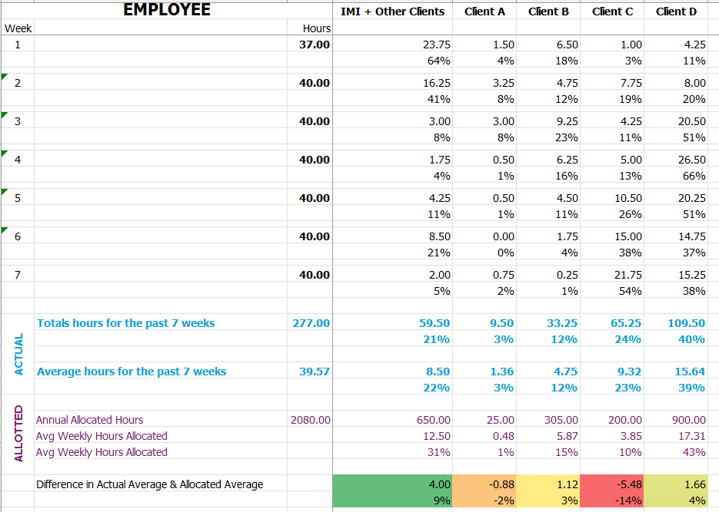

Slide 18
Practical tip
Regularly ASK your teams
Is there anything on your to do list that makes no sense that it lives with you?
Is there anything you see someone else doing that it makes more sense for YOU to do?

Slide 19
questions

