Slide 1


Client Health Dashboard
and Hours Reporting
06.25.25

Slide 2

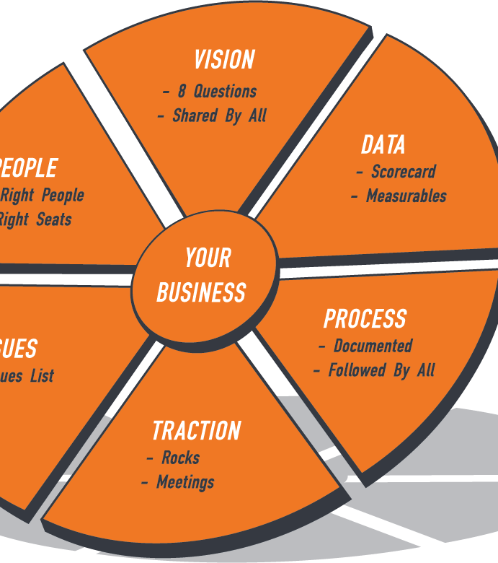

Notes:
Vision - Get everyone 100 percent on the same page with where your organization is going and how you’re going to get there.
People - Surround yourself with great people who share your core values and take accountability for their role in achieving your vision.
Data - Measure and track the essential numbers that drive the majority of your company’s progress so you can make informed decisions to propel you forward.
Issues - Become great at solving problems throughout the organization – setting them up, knocking them down, and making them go away forever.
Process - Systemize your business by identifying and documenting your core processes to create consistency and the ability to scale your organization.
Traction® - This means bringing discipline and accountability into the organization – becoming great at execution – taking the vision down to the ground and making it real.

Slide 3


Slide 4


Slide 5
Staff Satisfaction
IMI’s Finances
IMI Growth
Client Health & Satisfaction
Client Hours

Slide 6
Client health & satisfaction
WEEKLY FOCUS AREAS
TEAM HEALTH
& CAPACITY
Client Relationship
Hours & Accountability
Budget Performance

Slide 7

Do we have the right people in the right roles for this client?
Are there any performance or communication concerns?
Is anyone on the team stretched too thin or not fully utilized?
Who has stepped up recently that deserves recognition?
Team Health & Capacity

Slide 8

Do we have a good working relationship with the client?
Have they given us any negative feedback recently?
Have there been signs of frustration, hesitation, or avoidance?
Is there anyone on the client side who’s becoming a blocker or champion?
Client Relationship

Slide 9

Are we over or under budgeted hours this month?
Has there been any time posted to pro bono?
Do we need to recommend an hours increase or a change in scope?
What traction have you made toward your client goal(s) this month? Is anything getting in the way?
Hours & Accountability

Slide 10

Is all revenue targeted to come in as budgeted?
Are there any anticipated or unbudgeted expenses we should flag now?
Is the client board or finance committee aware of any key variances or concerns?
Budget Performance

Slide 11

questions

