Slide 1



Team Leads Meeting
05.22.2024

Slide 2
Don’t forget to record meeting ☺

Slide 3
What is monday.com
monday.com is a cloud-based work management platform that helps businesses automate their workflows and manage their projects, tasks, and resources in one place.
The beauty of monday.com lies in its flexibility—it can be used for any workflow and is fully customizable.

Slide 4
Benefits of using monday.com
Keeps everyone at IMI on the same page.
Provides a framework for more consistent operating procedures.
Visibility of status on different projects.
Offers assurance that someone could fill in for you if absent.
Helps with training and onboarding new employees.
Helps ensure smoother client or employee transitions.
A key component in IMI earning our Accreditation!

Slide 5
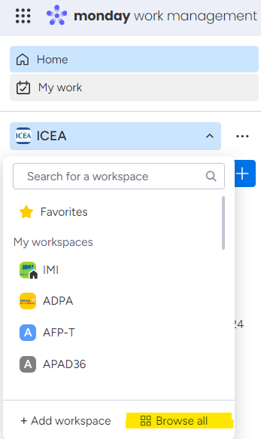
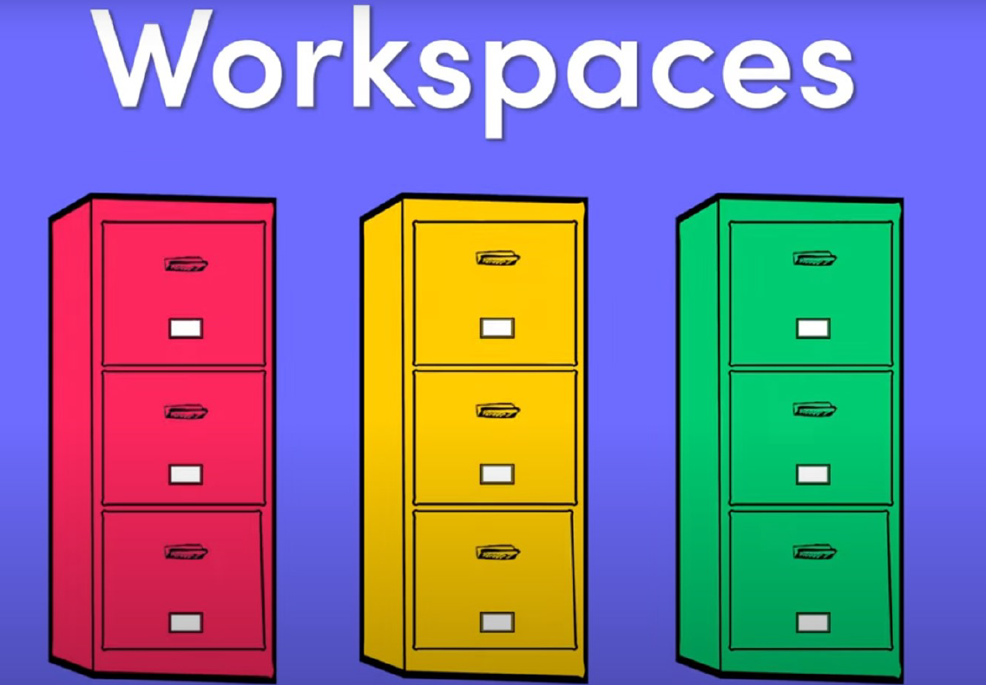

Slide 6
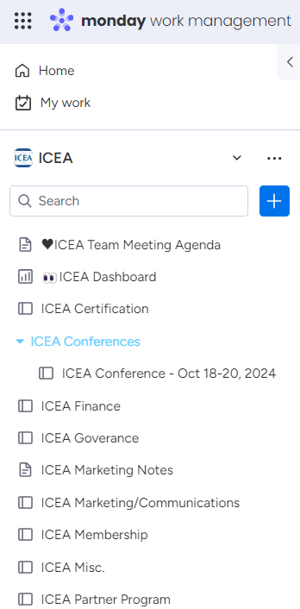
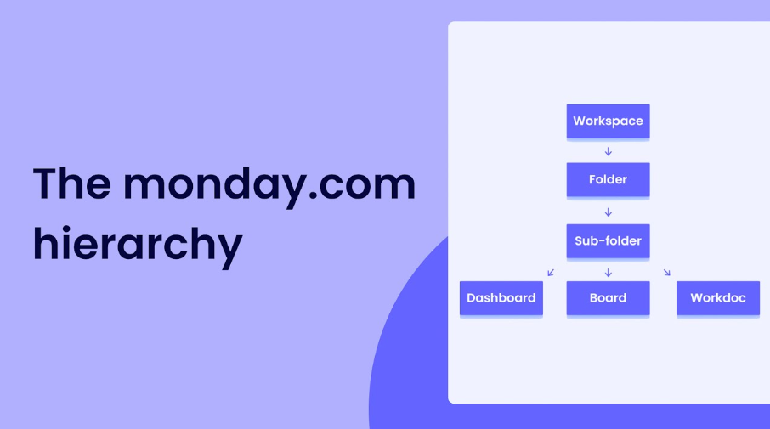

Slide 7
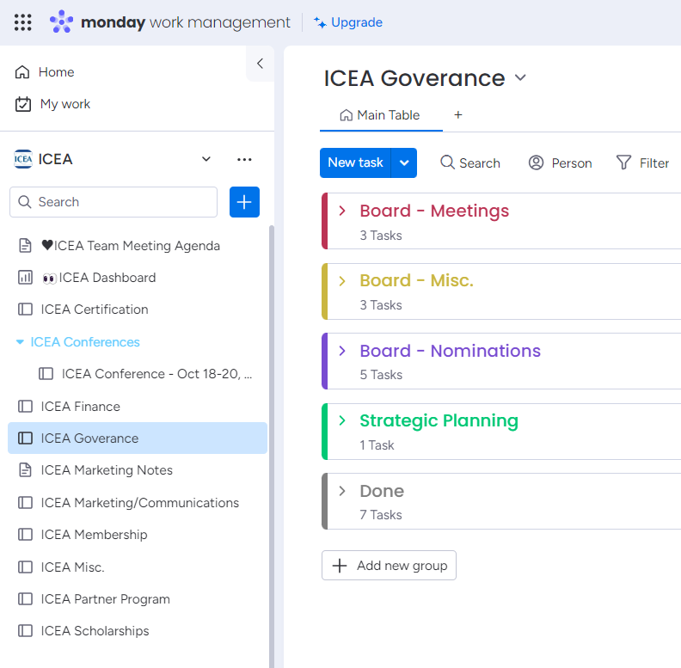
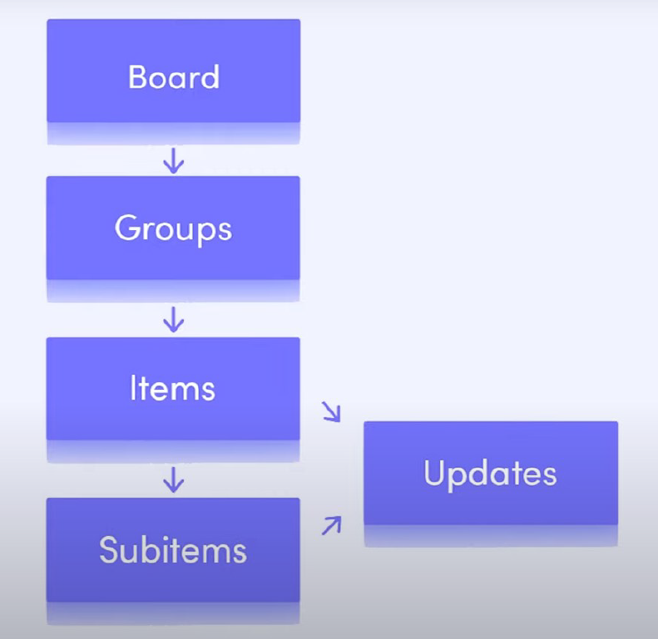

Slide 8
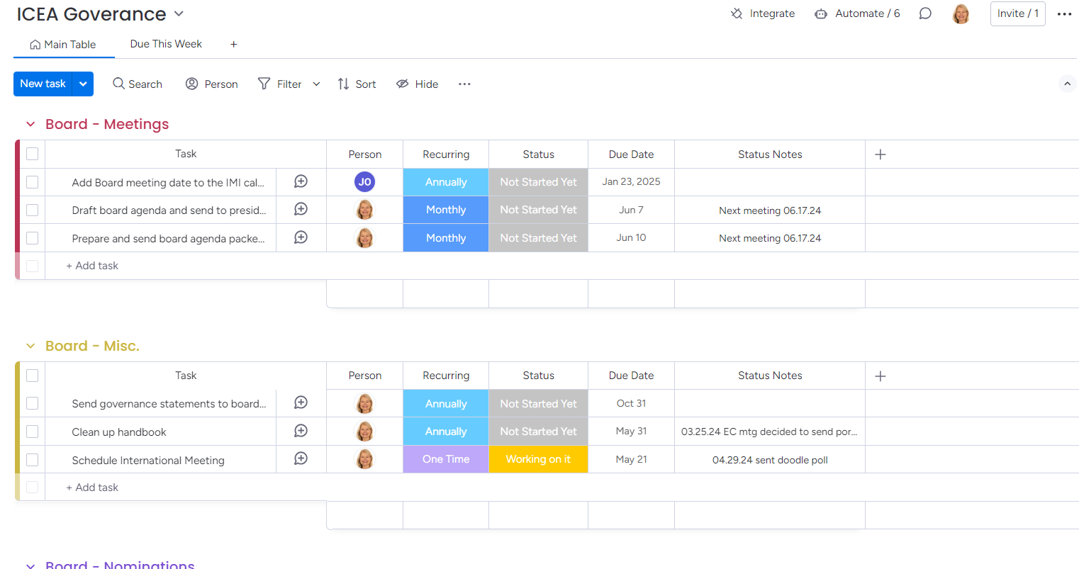
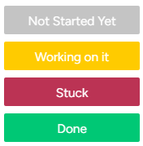
Groups
Items
Sub-items
Person
Recurring
Status - defaults
Due Date
Status Notes
Automations
Search
Person
Filter
Views

Slide 9
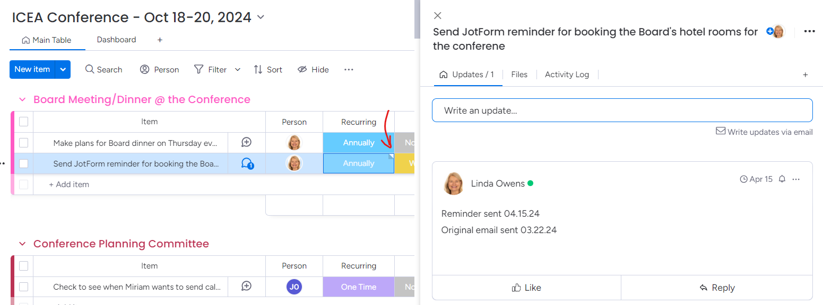

Slide 10
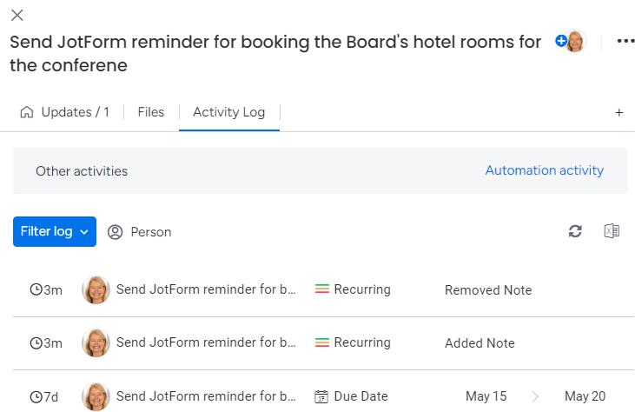

Slide 11
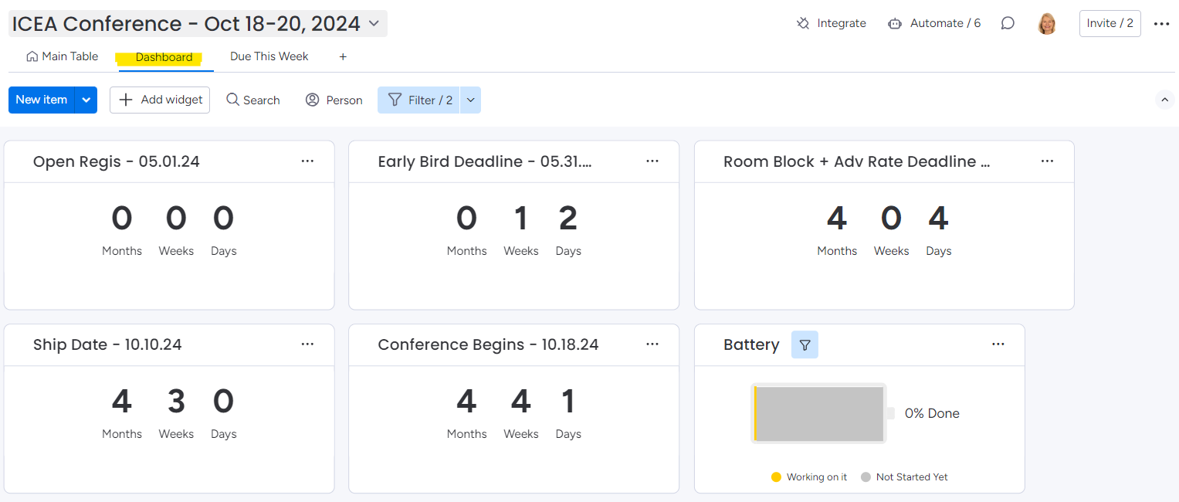
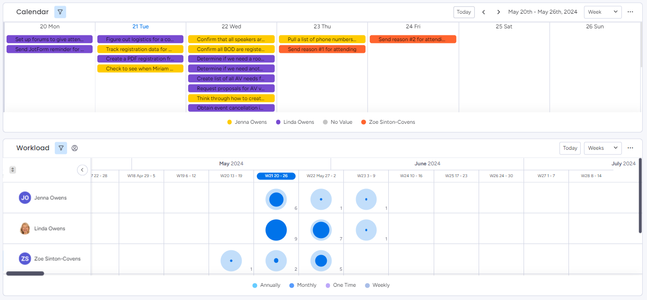

Slide 12
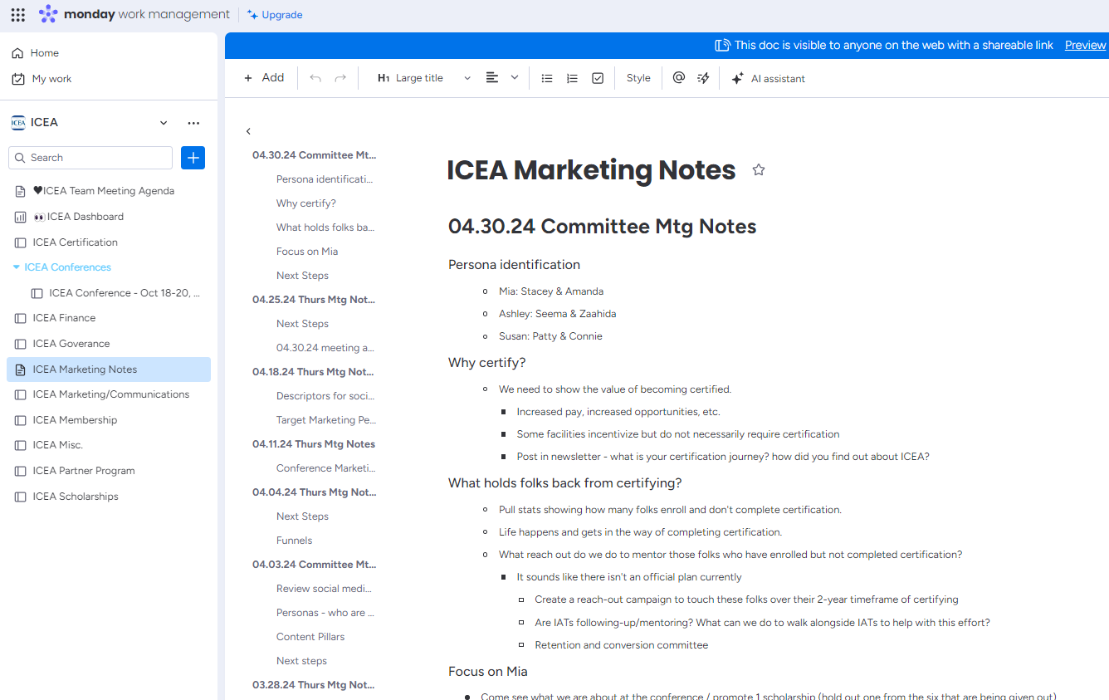

Slide 13
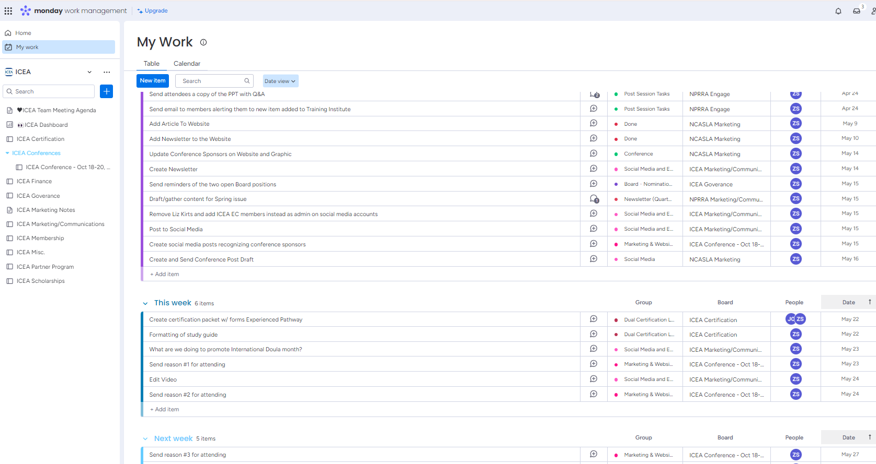

Slide 14
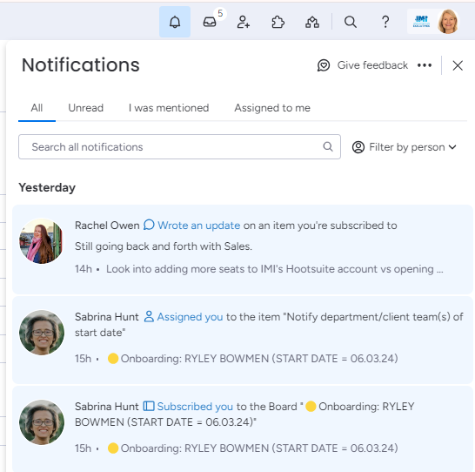
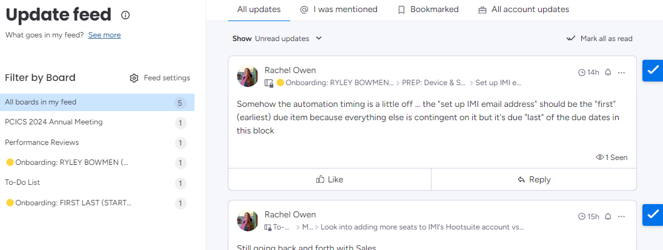

Slide 15
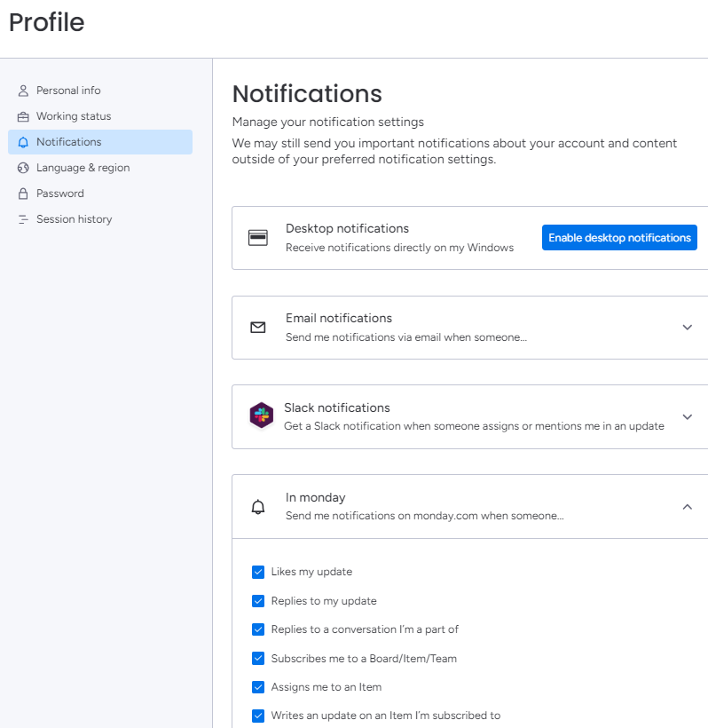

Slide 16
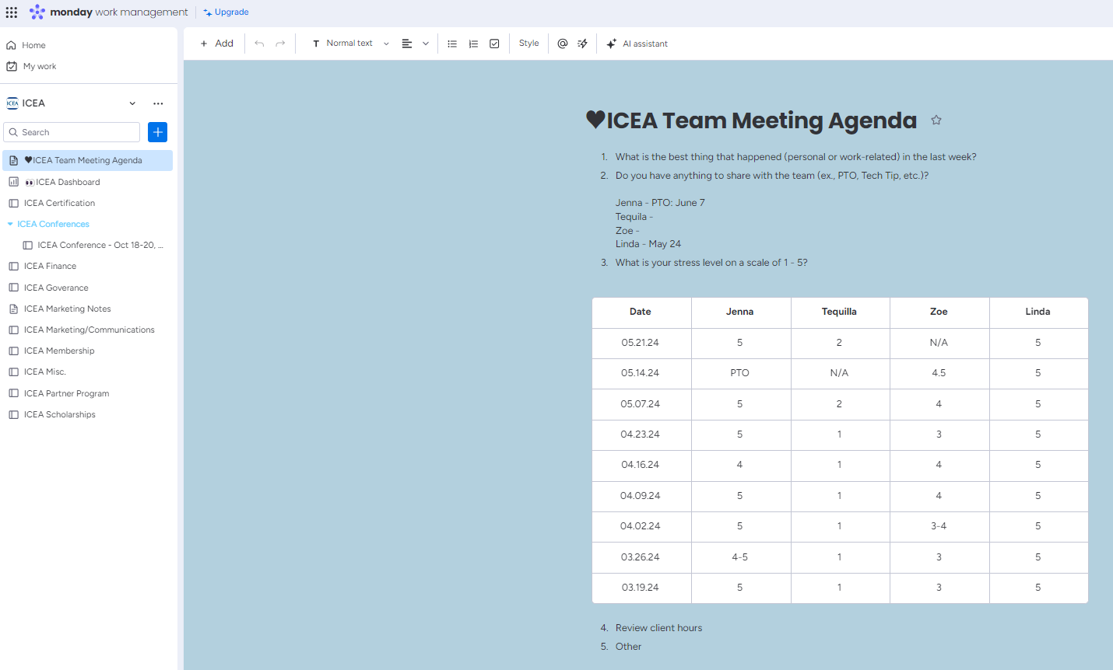

Slide 17
Next Steps
All teams/departments should begin using it as soon as possible.
If a client team isn’t using monday.com yet, I will create a workspace using a template.
If a department team isn’t using monday.com yet, I will work with the head of that department to create a workspace.
Since this is a key component in IMI earning our Accreditation, we have set a due date for everyone using by 09.01.24.
We will repeat this presentation during the 06.03.24 staff meeting.
We will allot time during future staff meetings to dive deeper and show some other features of monday.com.

